Slide 1



Embedded Systems: Interrupts

Slide 2
Today
Why do we need interrupts?
Block diagram
Interrupt handling
Code example

Slide 3


Why do we need interrupts?
Notes:
Why do we need interrupts?
First discuss in class what the picture could mean in the context of interrupts.
Suppose you are watching Netflix and ordered a pizza.
You could stand up and go to the front door every 5 minutes to check if the pizza guy arrived. This is called polling.
You would have to pause the program every 5 minutes meaning it would take much longer to finish.
It would be much more convenient if the pizza guy gave you a signal (interrupt) when he arrives. That’s why the door bell is invented.
This way you can
do your main task (watching Netflix)
at the interrupt (doorbell) execute the interrupt handler quickly (pay the pizza guy and receive the pizza)
resume your main task

Slide 4
In code: polling versus interrupts
while (true)
{
if (BtnPressed())
DoBtn();
activity1();
if (BtnPressed())
DoBtn();
activity2();
if (BtnPressed())
DoBtn();
activity3();
}
while (true)
{
activity1();
activity2();
activity3();
}
interrupt
void BtnIsr()
{
DoBtn();
}
Notes:
Polling whether a button is pressed is what you have learned in the first semester.
Discuss in class:
Looking at the code, what are the advantages / disadvantages of interrupts w.r.t. polling?

Slide 5
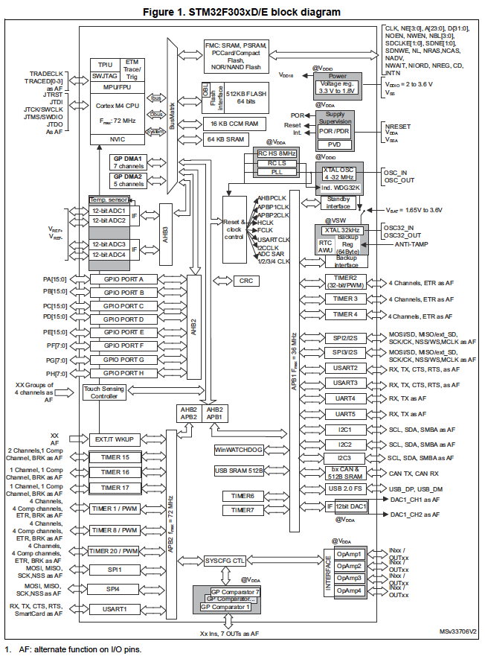
Interrupts - overview
Notes:
Block diagram is of STM32F303xD/E MCU.
The NVIC is the Nested Vectored Interrupt Controller.
The NVIC is able to handle up to 74 maskable interrupt channels (not including the 16 interrupt lines of Cortex®-M4) and 16 priority levels.

Slide 6
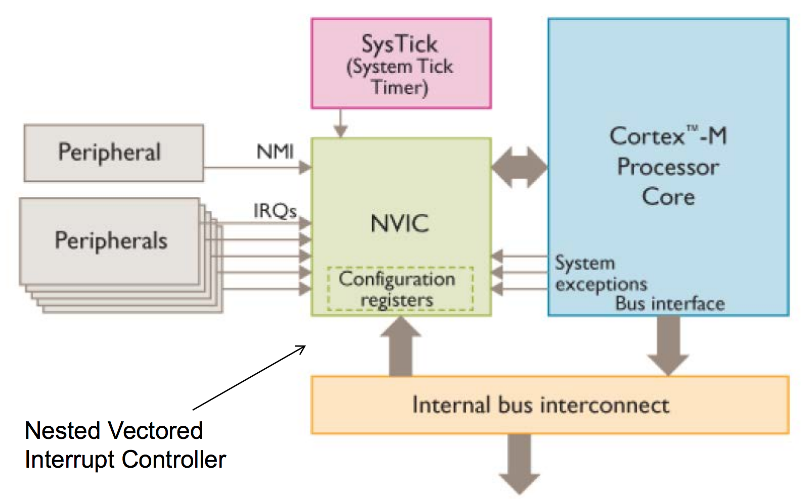
NVIC – Nested Vector Interrupt Controller
Notes:
The NVIC handles both interrupts and exceptions.
Interrupts handle external events
Exceptions handle internal events like instruction faults (e.g. divide by zero)

Slide 7
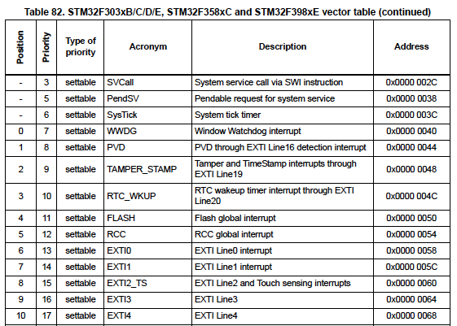
Vector table
from the reference manual:
(only a part of the vector table is shown)
Vector table is located at start of RAM.
It contains exception and interrupt vectors pointing to the corresponding handlers.
It is created by the startup file, e.g. startup_stm32f303xe.s.
﻿See the startup file for the names of the interrupt handlers.
vector for external interrupt 0. After using NVIC_EnableIRQ(EXTI0_IRQn); this vector will point to the EXTI0 interrupt handler with signature void EXTI0_IRQHandler(void)
Notes:
NVIC_EnableIRQ() is a CMSIS function and fills the specified vector with the address of the corresponding interrupt handler.
CMSIS header file:
The CMSIS header file contains the CMSIS definitions like register definitions and bitmask definitions. It can be found in C:\Users\<username>\.platformio\packages\framework-cmsis-stm32f3\Include\stm32f303xe.h. You can also in Visual Studio Code right click and then select ‘Go to Definition’ on a register name like ‘GPIOA’.
Startup file:
The names of the interrupt handlers can be found in the startup file startup_stm32f303xe.s (for NUCLEO-F303RE). This file can be found in C:\Users\<username>\.platformio\packages\framework-stm32cubef3\Drivers\CMSIS\Device\ST\STM32F3xx\Source\Templates\gcc\startup_stm32f303xe.s. The corresponding interrupt number to be used in the NVIC_Enable call can be found in the CMSIS header file stm32f303xe.h.

Slide 8
Interrupt handling
IF
status register
program counter
5
Instruction i of the main program is executed.
An external event occurs which will set the interrupt flag by hardware.
If enabled, an interrupt will be generated.
Program counter to instruction i+1 is saved and loaded with interrupt vector.
Interrupt handler is called. Typically the interrupt flag must be cleared here.
Interrupt handler is finished and the saved program counter is restored.
Instruction i+1 of the main program is executed.
2
5
main program
first instruction
3
interrupt
instruction i
1
instruction i+1
interrupt handler
7
4
points to interrupt handler
TIM1_CC
vector table
last instruction
6
Notes:
Exercise:
Explain this picture with the watching Netflix and pizza guy cartoon. Where is the doorbell? And what if the phone is ringing?
Important note:
The peripheral hardware requesting an interrupt will do so by setting an interrupt flag in the associated status register.
In the interrupt handler all interrupt flags associated with the interrupt vector should be checked and cleared if needed.
If not cleared, the interrupt handler will be called again!
Side note: An exception is the system timer tick (SysTick); the periodic timer requests an interrupt, but the interrupt flag will be automatically cleared when the interrupt handler runs.

Slide 9
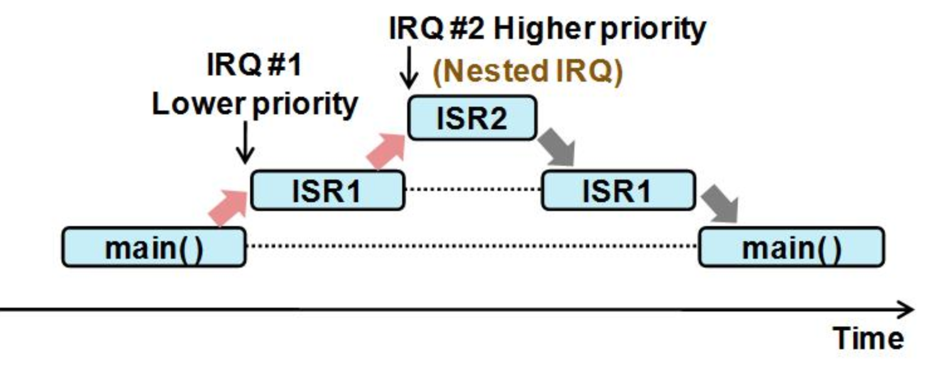
Interrupt nested call sequence
Notes:
STM32 MCU’s support nested interrupts.
This means, like in the picture, ISR2 can interrupt ISR1. The priority can be set using the CMSIS function NVIC_SetPriority(). The default priority is 0 for every interrupt. This is the highest possible priority.

Slide 10
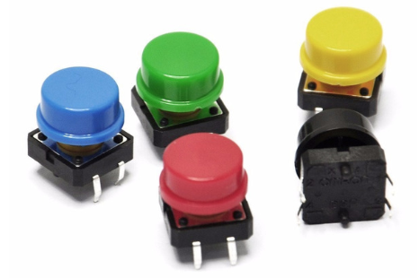

Application: button
STM32 board
3.3V
internal pull-up
Configuration
Set GPIO pin to input (GPIOx_MODER).
Configure pull-up, pull-down or none (GPIOx_PUPDR).
Connect GPIO pin to EXTI* interrupt (SYSCFG_EXTICR1 or SYSCFG_EXTICR2).
Select rising or falling edge (EXTI_RTSR1 or EXTI_FTSR1).
Enable Interrupt Vector with ﻿NVIC_EnableIRQ().
Unmask external interrupt (EXTI_IMR).
You can use a capacitor of 100 nF for debouncing. No debouncing in sw. is needed then.
PA0
mux
EXTI* interrupt
capacitor 100 nF
cpu
GND
PA0 input in pull-up mode
PA0
3.3V
Discussion:
What are the different methods of reading button input?
What are the advantages / disadvantages of each method?
0V
button press
button release
interrupt on falling edge
interrupt on rising edge
Notes:
There are different methods to read button input:
Poll the button status on a regular basis, for example during the SysTick event.
Connect the button to an interrupt.
When connecting the button to an interrupt, it is better to debounce the button with a capacitor. Else the bouncing can generate many interrupts which can have undesired side effects.

Slide 11
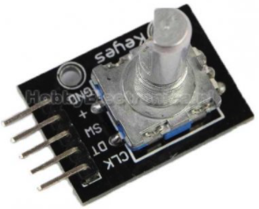
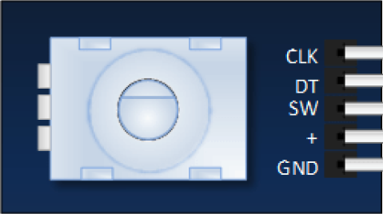
Application: rotary encoder
STM32 board
+3.3V
PB0
PA0
GND
+ SW DT CLK
Configuration
Similar as for two buttons
No pull-up resistors needed, they are already inside the Keyes KY-040
2x capacitor 100 nF for debouncing. No debouncing in sw. needed then.
mux
EXTI* interrupt
cpu
2 x capacitor 100 nF
GND
Keyes KY-040 rotary encoder
PA0 input in pull-up mode
DT
DT
CLK
CLK
1
2
1
2
left rotation
right rotation
Discussion: How would you determine left or right rotation?
Notes:
Reading the encoder using interrupts is one method.
The NUCLEO-F303RE board offers also a solution using timers which contain a special (quadrature) ‘encoder interface mode’ for this, just follow the recipe in the reference manual.
This mode can deal with jitter / bouncing of the encoder!

Slide 12
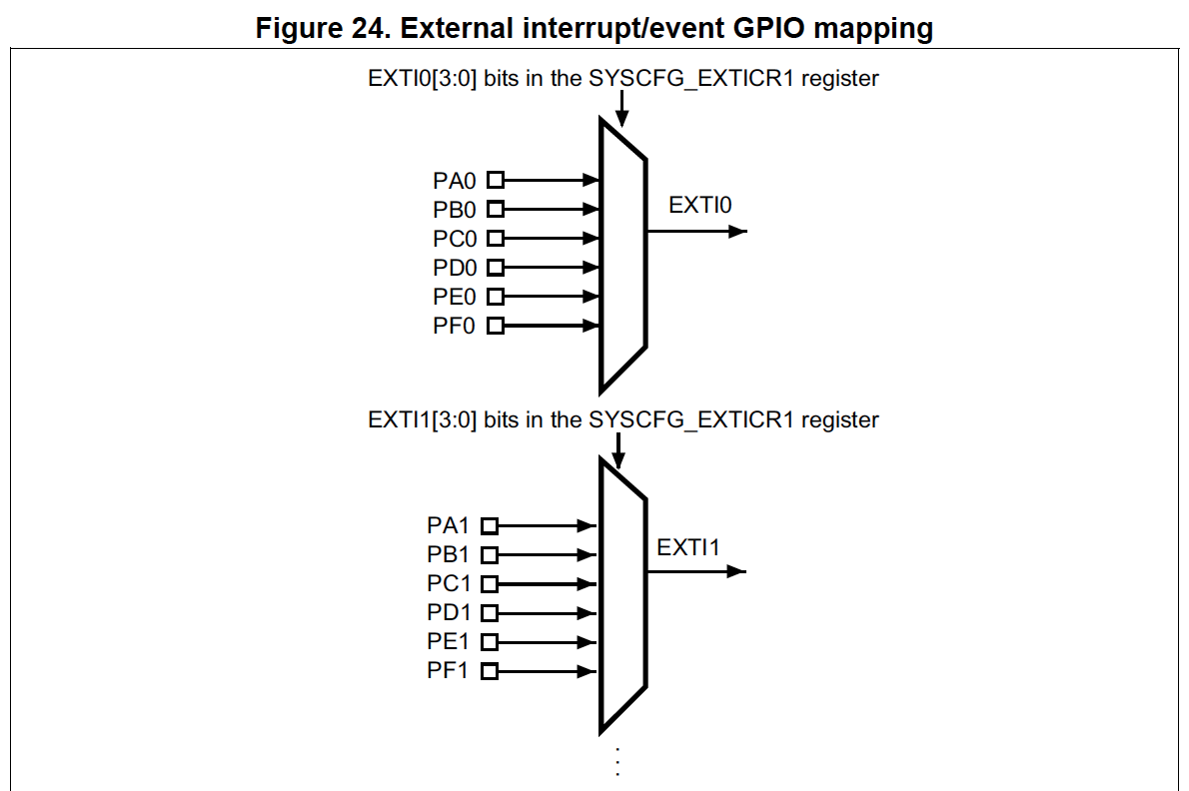
Interrupts - code example button Generate interrupt when button is pressed
Notes:
This picture from the reference manual shows that external pins can be connected to (in this case) external interrupt EXTI0 and EXTI1.
Such an external pin can be connected to a button, resulting in an interrupt being generated when the button is pressed or released (or both).
This can be done by setting the right bits in the corresponding SYSCFG_EXTICRx register.
Note: For SYSCFG (System Configuration) settings to have effect, the SYSCFG clock must be enabled. Normally this is done by the code generated by STM32CubeMX. The setting is done in the HAL_Init() call at the start of main(). Manually it can be done by setting the SYSCFGEN bit in the RCC_APB2ENR register.
In case of the NUCLEO-F303RE board it can be deduced from the startup file (startup_stm32f303xe.s) that the name of the corresponding interrupt handler is EXTI0_IRQHandler.
It can be that multiple interrupts are combined, for example with the EXTI9_5_IRQHandler. This means that one handler is used for EXTI5 .. EXTI9. In that case it might be needed to determine the source of the interrupt in the interrupt handler which can be done by checking the pending interrupts bits in the EXTI->PR register.
Discuss in class how the source of the interrupt can be determined in the interrupt handler.

Slide 13
Interrupts - code example button Generate interrupt when button is pressed
definition interrupt EXTI* interrupt handler
extern "C" void EXTI*_IRQHandler(void) // Do not forget the ‘extern “C”’ in case of C++
{
EXTI->PR = EXTI_PR_PR*; // Reset interrupt flag of EXTI*. This is needed otherwise the // interrupt handler will be called again.
// handle interrupt here
}
connect pin PA0 to external interrupt EXTI*
SYSCFG->EXTICR[*] = (SYSCFG->EXTICR[*] & ~SYSCFG_EXTICR*_EXTI*) | (0b**** << SYSCFG_EXTICR*_EXTI*_Pos); // pin PA0 to interrupt EXTI*
Tip:
Check out the Speaker Notes and carefully check in the reference manual which SYSCFG_EXTICR* register you need for your EXTI* interrupt.
configure and enable interrupt EXTI0
EXTI->FTSR = EXTI_FTSR_TR*; // Set interrupt EXTI* trigger to falling edge
EXTI->IMR = EXTI_IMR_MR*; // Unmask EXTI* line
NVIC_EnableIRQ(EXTI*_IRQn); // Enable EXTI* interrupt
Notes:
For * fill in the right values, see reference manual.
NVIC_EnableIRQ() is a CMSIS function.
Notes:
To get an interrupt when the button connected to PA0 is pressed, PA0 must be connected to external interrupt EXTI0 through setting the appropriate bits in the SYSCFG_EXTICRx register.
Then the EXTI0 interrupt must be configured and enabled.
As can be seen in the reference manual and also in the CMSIS device header file stm32f303xe.h (for NUCLEO-F303RE) there are four SYSCFG_EXTICR* registers (* = 1…4).
As can be seen in the code example on this slide, these registers can be accessed through the array SYSCFG->EXTICR[0…3]. Carefully check which register you need in the reference manual!
Notes:
The interrupt flag in the EXTI_PR register is reset by writing a ‘1’ to the corresponding pending bit. In the reference manual this can be seen because it is a so-called rc-w1 bit: ‘Software can read as well as clear this bit by writing ‘1’. Writing ‘0’ has no effect on the bit value.’
Resetting an interrupt flag can be done using EXTI->PR = EXTI_PR_PR*. Note that a bitwise OR operation is not needed as writing a ‘0’ for the other interrupt flags has no effect on the bit value. In fact, in this case using a bitwise operation like EXTI->PR |= EXTI_PR_PR* has the undesired side effect that all bits are cleared because writing a ‘1’ resets the bit.
Discuss in class:
What happens when the button bounces and there is no hardware debouncing?

Slide 14
Good interrupt handler design
Keep your interrupt handler short and simple.
Do not waste time in the interrupt handler, so no delay or print.
Avoid loops (they can hang).
To make sure variables shared between an interrupt handler and the main program are updated correctly, declare them as volatile.
See Speaker Notes for some important details!
Discussion:
How can you share information between a C++ class and the interrupt handler?
Notes:
Some additional remarks:
Note that interrupt handler can also be called ISR (Interrupt Service Routine).
It is possible to print from the interrupt handler using HAL_UART_Transmit(). This should only be done for debugging purposes. HAL_UART_Transmit() is a blocking call so it returns after the whole message is sent! As a side note: there is also HAL_UART_Transmit_IT() which is interrupt based. See https://stm32.programmingpedia.net/en/tutorial/9707/uart-universal-asynchronous-receiver-transmitter-serial-communication.
Placing backward branches (busy-wait loops, iterations) in the interrupt software should be avoided if possible. The percentage of time spent executing interrupt software should be small when compared to the time between interrupt triggers.
The volatile keyword is used to indicate to the compiler that the variable can be changed by code outside the current scope. It forces the variable always to be read from memory and written back to memory rather than keeping it in a temporary register. If the code is single threaded, this suffices to allow an ISR to access global variables.
Discussion:
To share information between a C++ class and an ISR is not trivial. There are a few possibilities. In all cases some global object is needed because the ISR is not part of the C++ class context.
Use a global variable (declare as volatile).
Call a static class member function from the ISR.
Call a (non-static) member function from the ISR using a global class pointer.
Discuss the advantages / disadvantages of each method.

Slide 15

Challenge: How to determine a short and long button press?
STM32 board
3.3V
PA0
internal pull-up
capacitor 100 nF
make a state diagram!
GND
PA0 input in pull-up mode
short press > 10 ms and < 500 ms PA0 signal
long press > 500 ms PA0 signal
falling edge
rising edge
Notes:
When using buttons for user input it can be convenient to be able to determine both a short press and a long press.
This can be done without polling by using interrupts.
Discuss in class:
Which interrupts would be needed and what the task would be of the interrupt handler(s).
How to do debouncing of the buttons, hardware or software?
This discussion is input for the assignment of this module.

Slide 16
References
https://deepbluembedded.com/stm32-arm-programming-tutorials/
https://embedded-lab.com/blog/stm32-tutorials/
https://www.keil.com/pack/doc/CMSIS/General/html/index.html
https://community.arm.com/arm-community-blogs/b/architectures-and-processors-blog/posts/how-much-stack-memory-do-i-need-for-my-arm-cortex--m-applications

